Slide 1
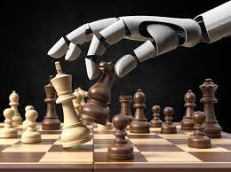

Artificial intelligence (AI) system for chess training
Encadrants:
Marc Plantevit
Idir Benouaret
Challenge : How to improve a player’s level in chess efficiently ?
Vincent Tardieux

Slide 2
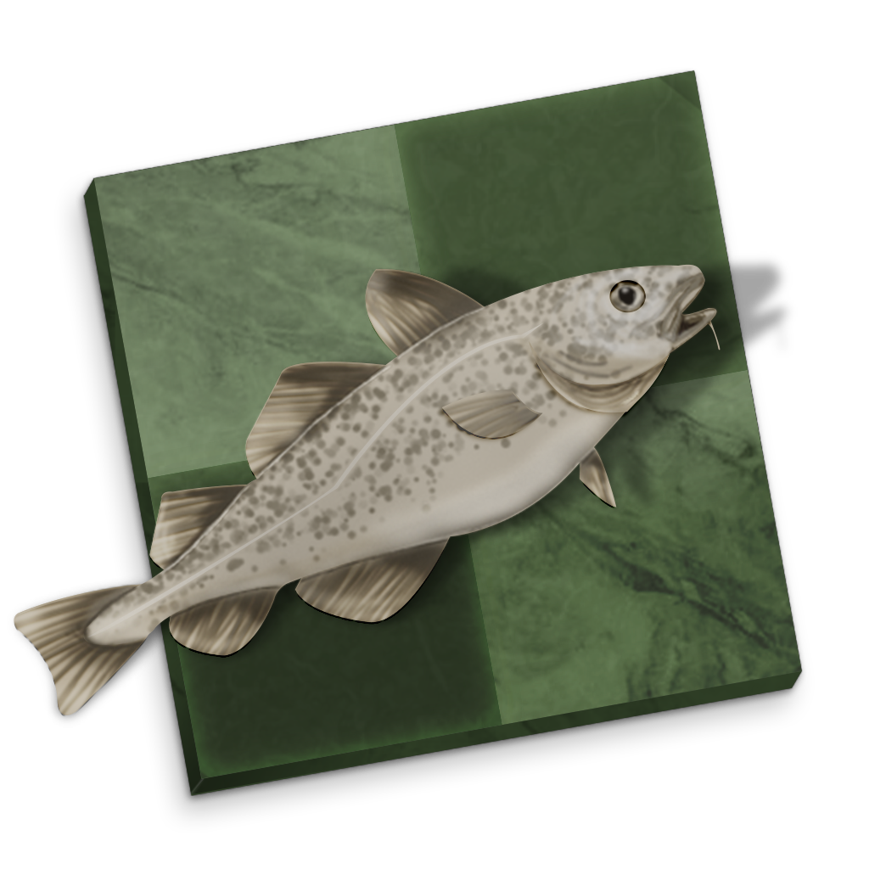
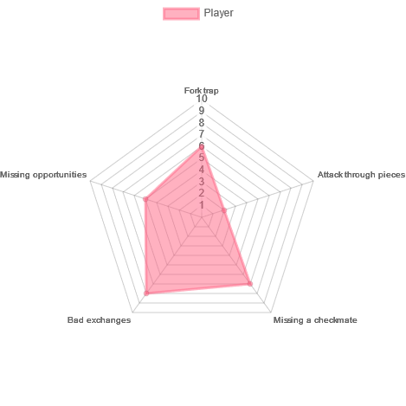
Games :
-Username
-Elo
-Type
-Time control
Blunders detector
(Stockfish)
Categorize Blunders
Radar Plot:
Personnalize chess puzzles

Slide 3
Model (Hypothetically)
Use of oriented graphs
Every node is a piece
Links between nodes shows either :
attacking or defending another piece
(that link can either be implicit or explicit,
it is yet to be determined)
B
Attacking
r
B
Protecting
R

Slide 4
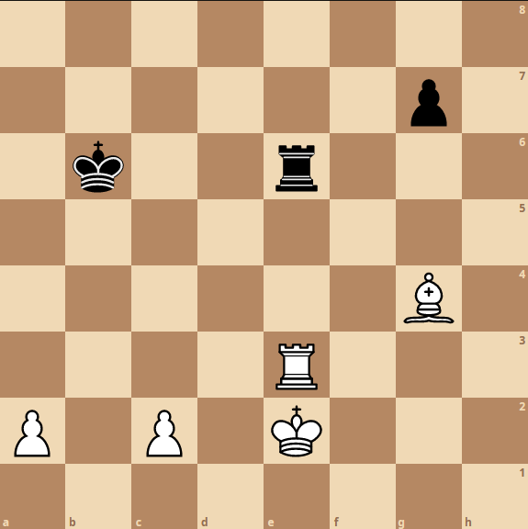
Example :
K
Protecting
R
Protecting
Attacking
B
r
Protecting
Attacking
k
p
P
P
Snapshot of a blunder (Bad exchange)

Slide 5
Graphs Neural Network :
Snapshot of a blunder in a graph structure
Input
Output
Hidden layers
Radar Plot with blunders types

Slide 6
Personnalize chess puzzles
A list of chess puzzle picked between the categories with most blunders
Radar plot
Associating puzzles
Using Lichess’s puzzles database
List will contain few categories

Slide 7
Any Questions ?

